Slide 1
Design Thinking

Slide 2
A. Definition:
Tim Brown presented a fantastic definition of Design Thinking:
“Design Thinking is a human-centered approach to innovation that draws from the designer’s toolkit to integrate the needs of people, the possibilities of technology, and the requirements for business success.”

Slide 3
Features/Key Takeaways
Design Thinking is a strategy for creative problem solving by prioritizing customers’ requirements above everything else.
It helps to engage a person in several opportunities like experimenting and creating a prototype model, gathering feedback from customers and redesigning the product using innovative solutions.
You can apply design thinking to various fields such as architecture, engineering, business, etc.
Design Thinking is a solution-based approach where you focus on finding solutions to the problems in contrast to the problem-based approach. The problem-based thinking approach focuses on finding obstacles and limitations on why a problem exists.

Slide 4
C. Why is Design Thinking Important?
If you think like a designer, it can transform how your organization develops products, services, processes, and strategies. It brings together the desirability from the customer’s perspective with what is technologically feasible and economically viable.
It also provides various opportunities for people who aren’t trained as designers to utilize creative tools so that they can tackle a vast range of problems/challenges.

Slide 5
There are also some essential aspects in which design thinking helps, and they are:
The main objective is to solve the customer’s requirements
Helps in tackling ambiguous and challenging problems
Drives people to create innovative solutions
It helps organizations to run faster with more efficiency

Slide 6
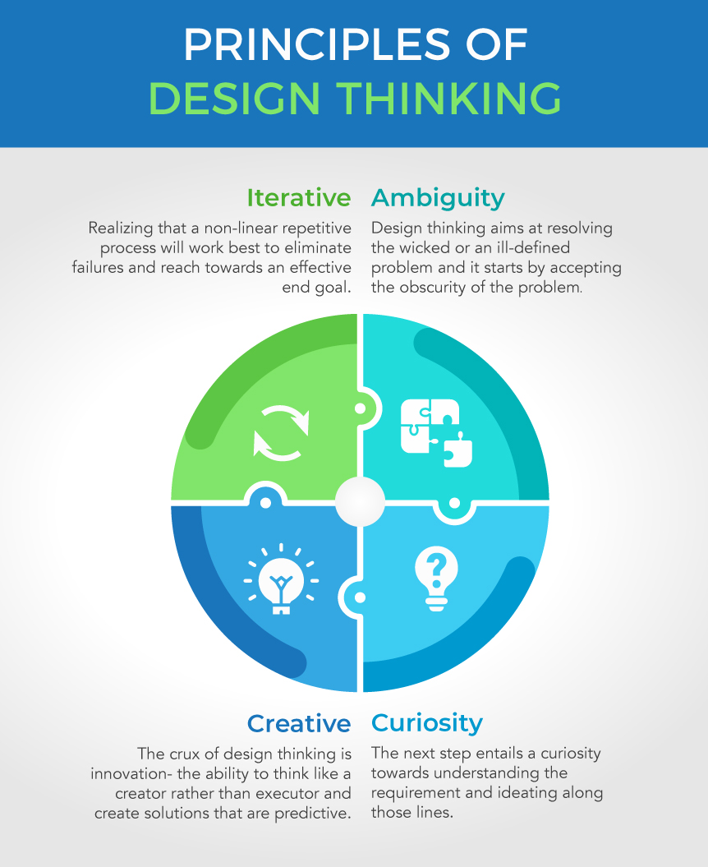

Slide 7
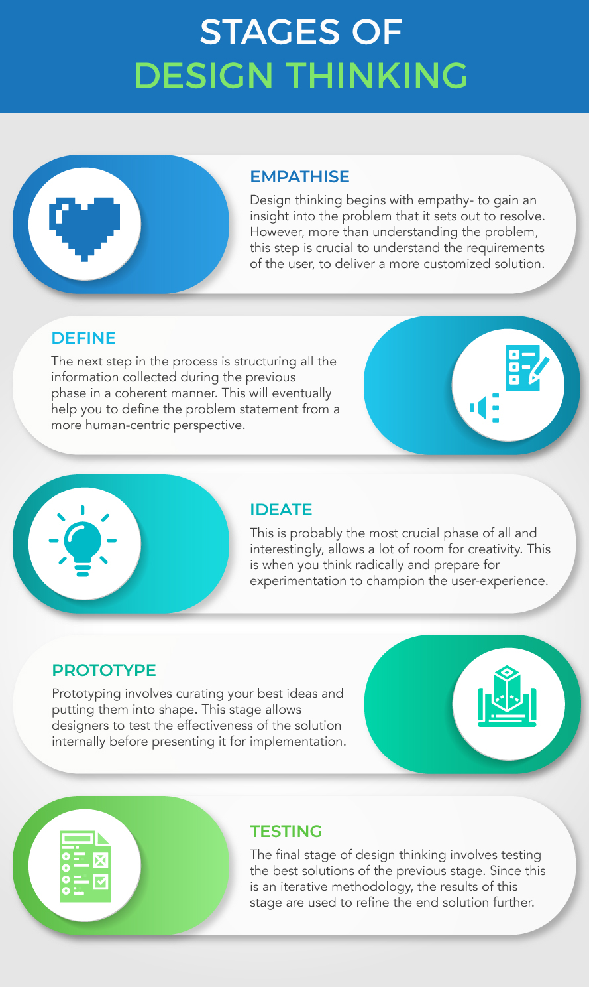

Slide 8
Applications of Design Thinking
Business:
Design thinking is most popular in businesses. It helps them in optimization processes, especially with respect to product creation, marketing, and contract renewal.
Considering that these processes require a good amount of focus on their customers, design thinking proves to be immensely useful in their assistance.
In businesses, design thinking helps design thinkers not only develop deep empathy for their customers but also to create solutions that tend to their specific needs.

Slide 9
Information Technology
The IT industry makes a lot of products that require trials and proof of concepts. The industry needs to empathize with its users and not simply deploy technologies.
IT is not only about technology or products, but also processes. The developers, analysts, consultants, and managers have to brainstorm possible ideas for solving the problems of the clients. This is where design thinking helps a lot.

Slide 10
Education
The education sector in our economy demands the most when it comes to creative solutions.
It essentially can make the best use of design thinking through student feedback.
Feedback from students on their requirements, goals, and challenges in the classroom can prove to be useful in easy problem-solving.
That is, by working on their feedback, the design thinks can come up with relevant and creative solutions to address their issues.

Slide 11
Healthcare
Design thinking plays a vital role in the healthcare industry as well.
The expenditure in this sector is healthcare is continuing to increase by the day.
A major concern of the experts worldwide is about bringing quality healthcare to people at lower costs.

